Slide 1

ParkSmart
Capstone Project Phase A
25-1-R-5
Research of Pattern Recognition and Visualization Based on Personal Data for Support and Quality of Life Improvement for Parkinson's Patients.
Presented by:
Yuval Shekel
Noam Vallach
Supervison:
Dr. Julia Sheidin
Dr. Avital Shulner Tal
Notes:
Hi, my name is Yuval, and together with Noam, we will present you our project. Our project is called ParkSmart. It focuses on identifying personal patterns in the data of Parkinson's patients. The goal of our project is to improve the quality of life for Parkinson's patients and improves treatment approaches. This is a research project conducted under the guidance of Dr. Julia Sheidin and Dr. Avital Shulner-Tal. Our project is based on data collected from Michael, who is here with us today.

Slide 2
Our project
Parkinson's: A neurodegenerative disease with no cure
Personal patterns improve disease understanding
Integrating technology to analyze patient data
Presenting patterns through accessible and clear methods
Enhancing quality of life and treatment
Notes:
Parkinson's is a neurodegenerative disease with no cure, characterized by motor and non-motor symptoms. By integrating technology, we aim to uncover patterns and understand the connect between daily activities to symptoms. These patterns will present by accessible and clear methods.

Slide 3
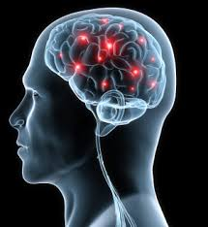
Parkinson's Disease
A neurodegenerative disease of the nervous system
Symptoms: tremor, rigidity, slow movements, sleep problems, depression
Caused by dopamine deficiency in the brain
Causes: combination of genetic and environmental factors
Notes:
Parkinson's disease is caused by a deficiency of dopamine in the brain. Its symptoms include tremors, rigidity, slow movements, sleep problems, and depression. The disease results from a combination of genetic and environmental factors. The disease has no cure, but various treatments can help to slow its progression and help manage its symptoms.

Slide 4
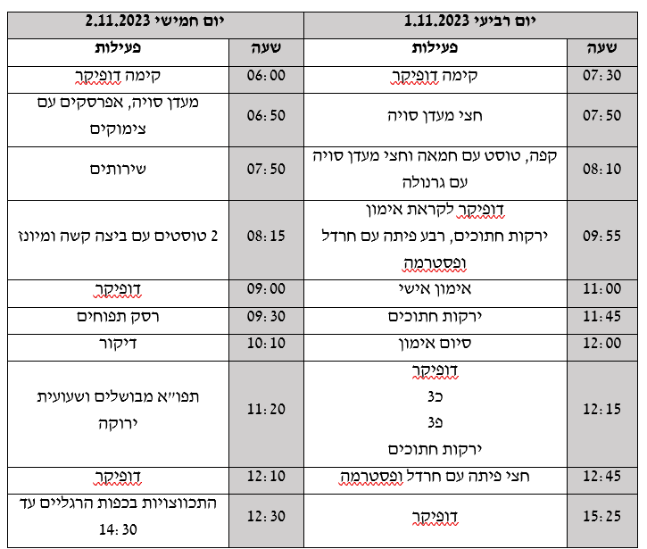
Collected Data
User-Centered Design approach – the process revolves around Michael’s needs and feedback
Data gathered in a previous project
Personal data on the patient's daily life
Sleep times, medications, diet, and physical activity
Daily symptoms and their frequency
Unstructured data with multiple variables collected over time
Notes:
As part of a previous project, they collected data on the daily lives of Michael. As you can see, the data is organized in a table and contains many different of variables, such as sleep times, medications, diet, physical activities, and daily symptoms. The data is unstructured, meaning it is not organized in a fixed format. We use a User-Centered Design approach, focusing on the needs and feedback of Michael. We met with him and will continue to meet to ensure that the project helps improve his quality of life.

Slide 5
Data Pre-processing
Preparing data for advanced analysis tools
Converting data into a suitable format
A crucial step for accuracy and reliability
Notes:
In the first stage, we focused on understanding the collected data to identify its structure and key characteristics. Next, we will perform data pre-processing to convert the data into a format suitable for the analytical tools we plan to use. This process makes ensures the data is ready for complex analyses, and helping to identify relevant patterns.

Slide 6
Research Questions
What patterns can be identified from the existing data, and how can they be classified as good or bad?
How can these patterns be presented to the user in a clear and accessible way?
Notes:
The research questions we want to examine in our project are: The first question: What patterns can be identified from the existing data, and how can they be classified as good or bad? And the second question: How can these patterns be presented to the user in a clear and accessible way?"

Slide 7

Identifying Patterns
Helps find important relationships
Improves predictions and monitoring
Sub-group classification helps understand diseases
Machine learning techniques perform advanced analysis
Notes:
Identifying patterns in the data is a key aspect of our project. This process helps uncover important relationships within the data. As a result, it improves both predictions and monitoring for patients. To achieve this, we use in machine learning techniques, to perform advanced analysis on the collected data.

Slide 8
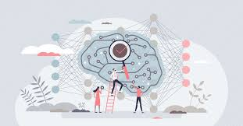
Tools for Identifying Patterns
Weka: A machine learning tool
Weka's advantage: User-friendly graphical interface
SVM: Pattern recognition for regression and classification
SVM's advantage: Analysis of complex data
Notes:
To answer the first research question of the project, we examined two main tools for pattern identifying from the collected data: Weka and SVM. Weka is a user-friendly software that includes an intuitive graphical interface and a wide range of machine learning algorithms. Its advantage lies in the ease with which analyses can be performed without the need for coding. On the other hand, SVM is an advanced classification algorithm used for pattern recognition and provides highly accurate predictions for complex data. Its strength is its ability to handle datasets with a large number of features and detect intricate patterns. However, working with SVM requires more technical knowledge.

Slide 9

Tools for Presentation of patterns
Purpose: using Explainable AI to create understandable and transferred artificial intelligence
SHAP: Explains feature contributions to predictions
SHAP's advantage: Consistent, theory-based, for complex models
LIME: Approximates predictions with simple models
LIME’s advantage: Flexible, tailored explanations for predictions
Notes:
To answer the second research question of the project, we examined Explainable AI tools that present patterns in a clear and accessible way. The tools tested were SHAP and LIME, both of which help understand the factors that influenced the model’s predictions but take different approaches: LIME focuses on local explanations and generates simple models to illustrate insights, making it flexible and easy to use. In contrast, SHAP provides a more comprehensive explanation, both locally and globally, and is based on solid mathematical theory, offering a deeper and more precise analysis.

Slide 10
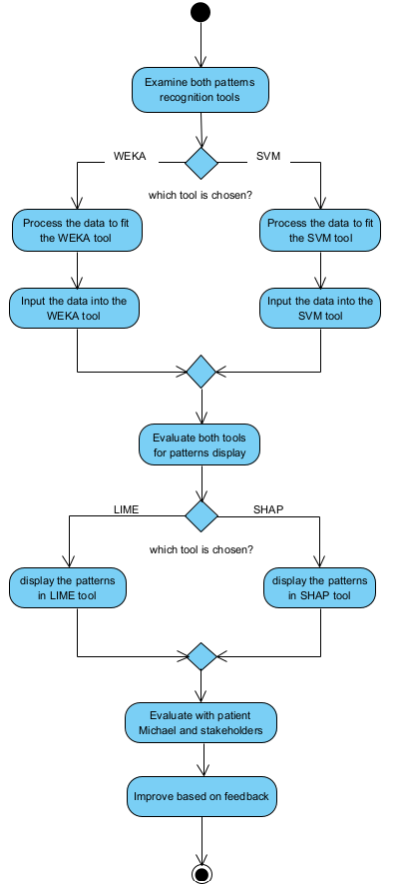
Work Process
Analysis of daily routines of patient
Use of technologies for pattern recognition
Presentation of patterns through XAI
User feedback for system improvement
Notes:
• Our workflow consists of several key stages. It builds upon a previous project in which personal data from the patient was collected. In the next phase, we will preprocess the data to format it appropriately for analysis with the selected tools. We will then choose and apply the most suitable tool to identify meaningful patterns in the data. After that, we will select the best tool for presenting the results and display them accordingly. Finally, we will collect feedback from the patient to refine the system and ensure that the generated insights are truly useful.

Slide 11
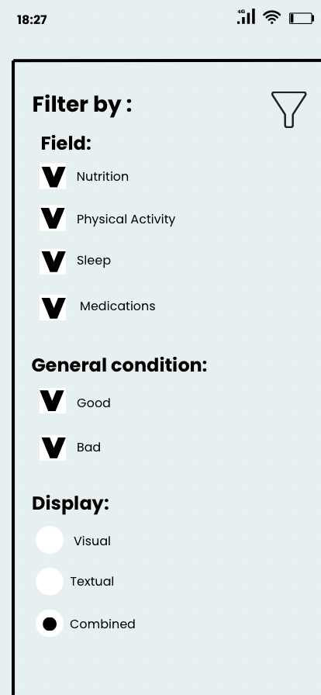
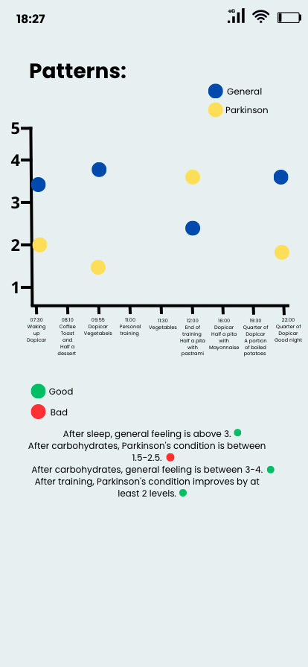
GUI
Notes:
Through this interface, the user can view patterns identified by the system in a personalized manner. They can select the specific area of interest, such as nutrition, physical activity, and more. In this example, all categories have been selected for display. Additionally, during a meeting with Michael, he mentioned that he wanted to see both positive and negative patterns, so we added an option to display both. Finally, users can choose how they wish to view the explanations—visually, textually, or in a combined format. In the left-side screen, since all categories were selected, all daily activities are displayed. The graph shows the overall well-being indicator in blue and the Parkinson’s-related well-being indicator in yellow, both on a scale from 1 to 5, allowing users to observe patterns through the plotted points. In the textual representation, patterns are listed alongside a green or red dot, indicating whether the trend is positive or negative. The goal is to help users understand how factors such as physical activity or specific dietary choices impact their symptoms, enabling them to make informed decisions that improve their quality of life.

Slide 12

Expected Challenges
Use of advanced, complex tools
Integration between different tools
Verification of the accuracy and utility of patterns
Notes:
The main challenges in the project are: Using advanced tools requires a deep understanding to ensure that the results obtained are both accurate and relevant. Additionally, integrating different tools necessitates technical adjustments to ensure seamless system operation. Another challenge is ensuring that the identified patterns are genuinely beneficial to the patient.

Slide 13

Evaluation Plan
Technical Evaluation - Checking tool suitability, functionality, and pattern Identification
User Evaluation - Ensuring insights are useful and clear for Michael
Notes:
To evaluate the success of the project in terms of technical evaluation, we want to assess the suitability of the tools for the intended purpose, the system’s functionality, and its ability to identify patterns and present them in a clear and useful manner in terms of user evaluation, we want to ensure that the patterns displayed by the system for Michael are clear, relevant, and beneficial, additionally, we want to check with him which format for presenting the patterns (visual, textual, or combined) is the most effective for him.

Slide 14


Thank You!
Now it's time for questions! ☺

